Slide 1

KC Housing Price Prediction
Ajith Murugaian
E20003

Slide 2
To predict the prices of houses in KC with the help of a multiple linear regression model.
PURPOSE OF THE PROJECT

Slide 3
The dataset
Given training dataset has 9761 rows and 21 columns.
Columns are Id, date, price, bedrooms, bathrooms, sqft_living, sqft_lot, floors, waterfront, view, condition, grade, sqft_above, sqft_basement, yr_built, yr_renovated, zipcode, lat, long, sqft_living15, sqft_lot15.
There are no missing values in the dataset.
Except date variable, all other variables are in number format.

Slide 4
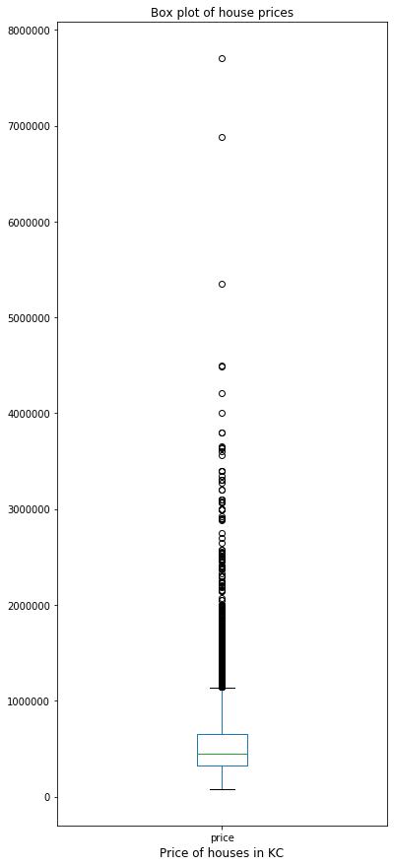
Univariate Analysis – Price(1)
Extremely right skewed distribution.
As the distribution is skewed right, mean is towards the right. Median is 450,000 while mean is 542,735. Max value is a very distant outlier 7,700,000.
Taking a log of the variable price can help bring the outliers closer. This can help in fitting the model better.

Slide 5
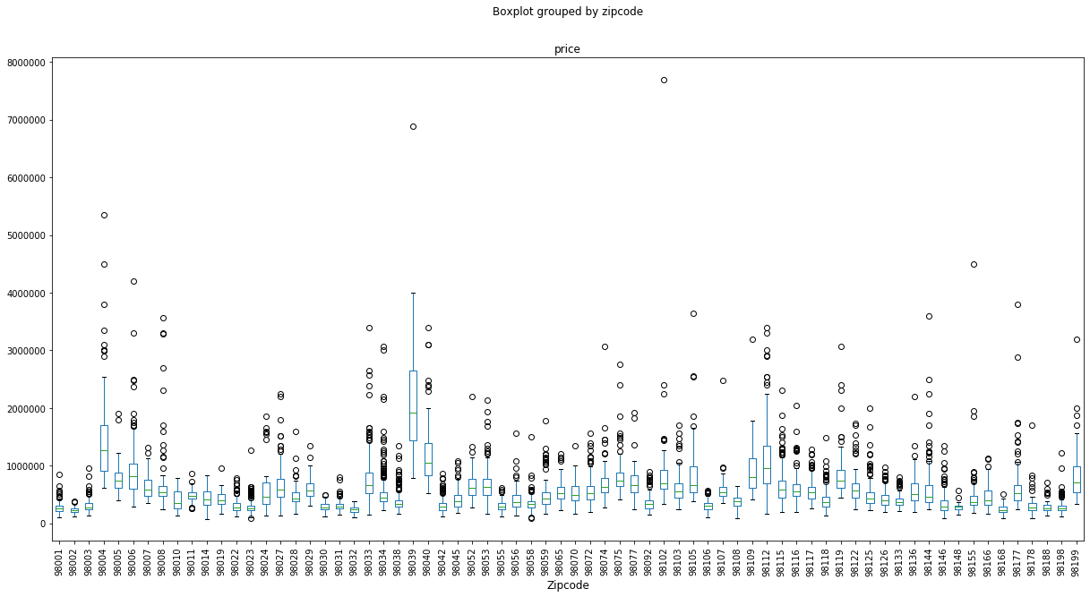
Univariate Analysis – Price(2)
98039 is significantly higher than every county. Why?
It is where billionaires like Jeff Bezos and Bill Gates live. Medina, a suburb on the outskirts of Washington.
So Zipcode will play a vital role in predicting the price of the house.

Slide 6
Univariate Analysis - Bedrooms
Bedrooms | Value count
3 | 4417
4 | 3094
2 | 1255
5 | 755
6 | 116
1 | 88
7 | 17
8 | 7
0 | 6
9 | 3
11 | 1
10 | 1
33 | 1
Most of the houses have 2 to 4 bedrooms.
One house has 33 bedrooms. It also has a sqft_living of just 1620 and just 1 floor. Its impossible to have that many bedrooms.
Considering it as an erroneous data and changing it to 3 bedrooms.

Slide 7
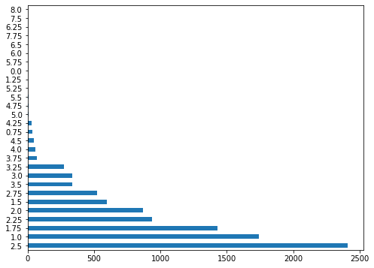
Univariate Analysis - Bathrooms
Ranges from 0.75 to 8.0.
Most people have 2.5,1 and 1.75 bathrooms.
Bathrooms being in decimals is a new concept. Digging further, found out the following.
1 bath: Bathtub(maybe with Shower); Sink; Toilet
3/4 bath: Shower; Sink; Toilet
1/2 bath: Sink; Toilet
1/4 Bath: Toilet

Slide 8
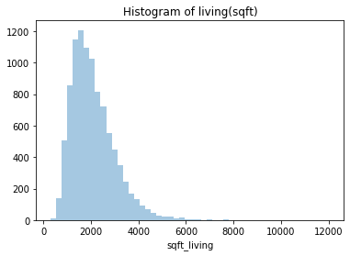
Sqft_living, sqft_basement, sqft_ above
sqft_living = sqft_basement + sqft_above
When basement = 0, sqft_living = sqft_above
It goes till 12,000. So taking a log will make be beneficial while fitting the model.
But we have to interpret it as much of increase/decrease in log(sqft_living) increases or decreases price of house.

Slide 9
Waterfront, view
price | bedrooms | bathrooms | sqft_living | sqft_lot | view | floors | waterfront | yr_built | grade
1950000 | 7 | 3.5 | 4640 | 15235 | 1 | 2 | 0 | 1965 | 11
1955000 | 3 | 1.75 | 3330 | 12566 | 4 | 1 | 1 | 1960 | 8
Even though the first house has more bedrooms, bathrooms, sqft_living, sqft_lot, floors, grade, the second one is built in front of a waterfront. Hence its more expensive. So waterfront plays an important role.
Views of houses without waterfront. 0: 8748; 1: 159; 2: 449; 3: 231; 4: 92
Views of houses with waterfront. 0: - ; 1: 1 ; 2: 5 ; 3: 12 ; 4: 64
We see that waterfront houses in general have a great view.

Slide 10
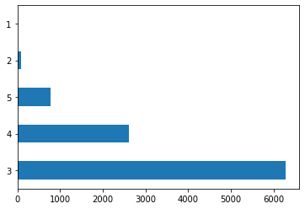
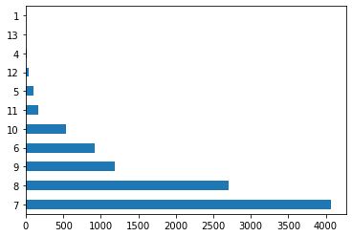
Condition Grade
Most of the houses have a condition of 3, 4 and 5. Very few houses have a condition of 1 or 2.
Grade ranges from 1 to 13. Most of the houses have a grade from 6 to 9.

Slide 11
Other Variables
Date – date on which the house was sold. If the data had spanned over a period of 10 years, we could have inferred the increasing cost of houses every year. But since our data spans only from 2014/05/02 to 2015/05/14, there isn’t any massive increase in price.
yr_renovated – 0 if it was not renovated. The year it was renovated, otherwise.
Lat, Long – we get an approximate location of the house from zip code, so lat, long estimates aren’t very useful for predicting price.
sqft_living15 – average house square footage of the 15 closest houses. Gives us an idea of the size of houses in the neighbourhood.
sqft_lot15 – similar to sqft_living15 but for the whole lot.

Slide 12
Bivariate Analysis(1)
 | price | bedrooms | bathrooms | sqft_living | sqft_lot | floors | waterfront | view | condition | grade | sqft_above | sqft_basement | yr_built | yr_renovated | zipcode | lat | long | sqft_living15 | sqft_lot15
price | 1 | 0.315763 | 0.527532 | 0.705052 | 0.094143 | 0.262954 | 0.274977 | 0.399658 | 0.044732 | 0.665567 | 0.611453 | 0.322383 | 0.051759 | 0.120472 | -0.05563 | 0.29928 | 0.023754 | 0.584807 | 0.077943
bedrooms | 0.315763 | 1 | 0.534279 | 0.592184 | 0.031167 | 0.193637 | -0.006851 | 0.085123 | 0.029832 | 0.362189 | 0.489871 | 0.31552 | 0.165999 | 0.02032 | -0.15774 | -0.01417 | 0.126138 | 0.399499 | 0.020135
bathrooms | 0.527532 | 0.534279 | 1 | 0.75893 | 0.079435 | 0.501899 | 0.061483 | 0.182988 | -0.115382 | 0.660925 | 0.692911 | 0.281433 | 0.499589 | 0.044756 | -0.20145 | 0.018453 | 0.217697 | 0.566076 | 0.068722
sqft_living | 0.705052 | 0.592184 | 0.75893 | 1 | 0.162786 | 0.366219 | 0.097203 | 0.285735 | -0.047938 | 0.764819 | 0.878989 | 0.435069 | 0.322723 | 0.043627 | -0.20376 | 0.05483 | 0.24017 | 0.758081 | 0.163545
sqft_lot | 0.094143 | 0.031167 | 0.079435 | 0.162786 | 1 | -0.00354 | 0.02942 | 0.099221 | -0.008722 | 0.115611 | 0.180913 | -0.000601 | 0.054043 | 0.001219 | -0.12609 | -0.09225 | 0.224524 | 0.145285 | 0.719922
floors | 0.262954 | 0.193637 | 0.501899 | 0.366219 | -0.003543 | 1 | 0.022443 | 0.031938 | -0.26539 | 0.461545 | 0.534801 | -0.242675 | 0.481926 | 0.013655 | -0.06448 | 0.044827 | 0.134683 | 0.289238 | -0.013269
waterfront | 0.274977 | -0.006851 | 0.061483 | 0.097203 | 0.02942 | 0.022443 | 1 | 0.402725 | 0.02403 | 0.088039 | 0.064297 | 0.082214 | -0.02701 | 0.101684 | 0.023656 | -0.00941 | -0.03923 | 0.097196 | 0.028499
view | 0.399658 | 0.085123 | 0.182988 | 0.285735 | 0.099221 | 0.031938 | 0.402725 | 1 | 0.059969 | 0.258123 | 0.170286 | 0.277021 | -0.05636 | 0.10975 | 0.075834 | 0.005503 | -0.07463 | 0.292435 | 0.079904
condition | 0.044732 | 0.029832 | -0.115382 | -0.047938 | -0.008722 | -0.26539 | 0.02403 | 0.059969 | 1 | -0.133313 | -0.153713 | 0.189828 | -0.3574 | -0.055525 | 0.00341 | -0.01762 | -0.10651 | -0.080423 | 0.002253
grade | 0.665567 | 0.362189 | 0.660925 | 0.764819 | 0.115611 | 0.461545 | 0.088039 | 0.258123 | -0.133313 | 1 | 0.756226 | 0.174216 | 0.447817 | 0.013053 | -0.18734 | 0.107977 | 0.201114 | 0.717835 | 0.118618
sqft_above | 0.611453 | 0.489871 | 0.692911 | 0.878989 | 0.180913 | 0.534801 | 0.064297 | 0.170286 | -0.153713 | 0.756226 | 1 | -0.046926 | 0.426642 | 0.014654 | -0.26422 | 0.002797 | 0.343715 | 0.726505 | 0.185507
sqft_basement | 0.322383 | 0.31552 | 0.281433 | 0.435069 | -0.000601 | -0.24268 | 0.082214 | 0.277021 | 0.189828 | 0.174216 | -0.046926 | 1 | -0.12956 | 0.063719 | 0.072077 | 0.109578 | -0.14591 | 0.21622 | -0.007685
yr_built | 0.051759 | 0.165999 | 0.499589 | 0.322723 | 0.054043 | 0.481926 | -0.02701 | -0.056361 | -0.357396 | 0.447817 | 0.426642 | -0.129559 | 1 | -0.228349 | -0.35361 | -0.15748 | 0.410001 | 0.32639 | 0.072152
yr_renovated | 0.120472 | 0.02032 | 0.044756 | 0.043627 | 0.001219 | 0.013655 | 0.101684 | 0.10975 | -0.055525 | 0.013053 | 0.014654 | 0.063719 | -0.22835 | 1 | 0.066908 | 0.035174 | -0.07307 | -0.003618 | -0.00726
zipcode | -0.05563 | -0.157735 | -0.201454 | -0.203761 | -0.126091 | -0.06448 | 0.023656 | 0.075834 | 0.00341 | -0.18734 | -0.264223 | 0.072077 | -0.35361 | 0.066908 | 1 | 0.271886 | -0.56043 | -0.279658 | -0.142375
lat | 0.29928 | -0.01417 | 0.018453 | 0.05483 | -0.092245 | 0.044827 | -0.00941 | 0.005503 | -0.017622 | 0.107977 | 0.002797 | 0.109578 | -0.15748 | 0.035174 | 0.271886 | 1 | -0.13327 | 0.052126 | -0.09462
long | 0.023754 | 0.126138 | 0.217697 | 0.24017 | 0.224524 | 0.134683 | -0.039227 | -0.07463 | -0.106514 | 0.201114 | 0.343715 | -0.145909 | 0.410001 | -0.07307 | -0.56043 | -0.13327 | 1 | 0.327811 | 0.248391
sqft_living15 | 0.584807 | 0.399499 | 0.566076 | 0.758081 | 0.145285 | 0.289238 | 0.097196 | 0.292435 | -0.080423 | 0.717835 | 0.726505 | 0.21622 | 0.32639 | -0.003618 | -0.27966 | 0.052126 | 0.327811 | 1 | 0.185966
sqft_lot15 | 0.077943 | 0.020135 | 0.068722 | 0.163545 | 0.719922 | -0.01327 | 0.028499 | 0.079904 | 0.002253 | 0.118618 | 0.185507 | -0.007685 | 0.072152 | -0.00726 | -0.14238 | -0.09462 | 0.248391 | 0.185966 | 1

Slide 13
Bivariate Analysis(2)
Correlation gives us the value of how strongly a single variable is linearly associated with another.
Sqft_above has a correlation value of 0.61 with price. On its own, it will do a decent job of predicting house prices. But a combination of many variables with lesser correlation values with price can do a better job of predicting.
For example, condition has a correlation of only 0.04 with price. But it explains variations in data which are not explained by other variables. So it is important. Whereas variations explained by sqft_above are already explained by sqft_living in a better way.

Slide 14
Process
The algorithm chosen to predict house prices is Linear Regression.
Variable selection is done using forward selection method. Starting with one predictors and then adding on predictors and checking if model improves. If it doesn’t, remove them.
Data is scaled so that coefficient interpretation is easier.
We are provided with 3 sets of data – train, validation and test.
Test data is kept unexposed to our model and variable selection is done with validation data.
R squared and RMSE values are checked at every stage. Model with the highest R- squared and lowest RMSE values are taken and given test data.

Slide 15
Selection of variables – Forward Selection
Variables | R_squared | RMSE
sqft_living | 0.47 | 473685.84
sqft_living, zip_codes | 0.82 | 308627.99
sqft_living ,zip_codes, view | 0.83 | 322868.31
sqft_living ,zip_codes, grade | 0.85 | 199872.80
sqft_living ,zip_codes, grade, sqft_lot | 0.84 | 206914.82
sqft_living ,zip_codes, grade, bedrooms | 0.84 | 204607.10
sqft_living ,zip_codes, grade, bedrooms, waterfront | 0.85 | 223251.20
sqft_living ,zip_codes, grade, bedrooms, floors | 0.84 | 204627.33
sqft_living ,zip_codes, grade, yr_renovated | 0.84 | 197682.10
sqft_living ,zip_codes, grade, yr_renovated, condition | 0.85 | 190316.97
sqft_living ,zip_codes, grade, yr_renovated, condition, sqft_living15, waterfront | 0.86 | 175970.87
sqft_living ,zip_codes, grade, yr_renovated, condition, sqft_living15, waterfront, view | 0.87 | 169629.76
log_sqft_living ,zip_codes, grade, yr_renovated, condition, sqft_living15, waterfront, view | 0.87 | 126629.04
Initially we have 0.47 R^2 and 473685.84 RMSE. After going through forward selection, we have brought it down to 0.87 R^2 and 126629.04 RMSE.

Slide 16
Testing our model on Test Data
Finally, we use the model on the test data.
R^2 : 0.87
RMSE : 127336.13
MAE : 75216. 81
We then take a sample of our results and do a visual comparison of our predictions and actual prices.

Slide 17
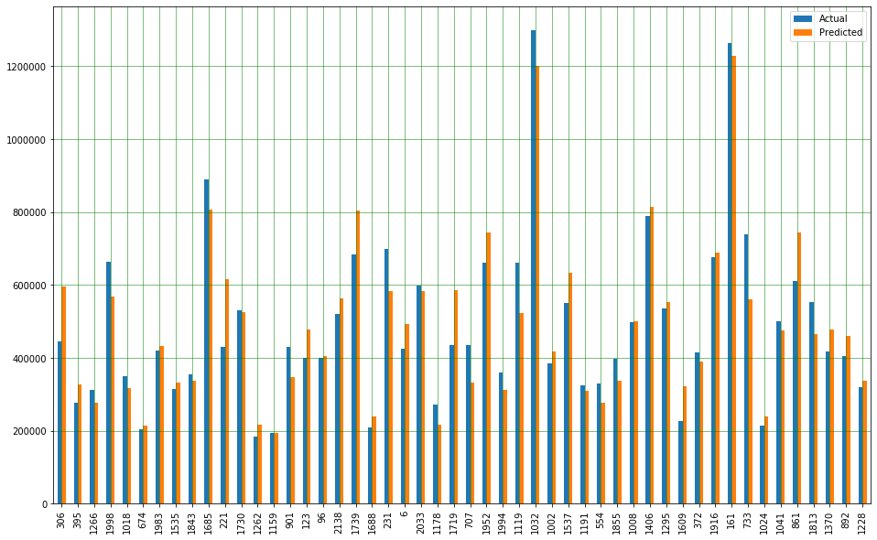
Visualisation of Test Results

